Slide 1
Processes and Threads
Processes have two characteristics:
  Resource ownership - process includes a virtual address space to hold the process image
  Scheduling/execution - follows an execution path that may be interleaved with other processes
These two characteristics are treated independently by the operating system

Slide 2

Threads...

Slide 3
Processes and Threads
To distinguish above two characteristics..
The unit of dispatching is referred to as a thread or lightweight process
The unit of resource ownership is referred to as a process or task

Slide 4
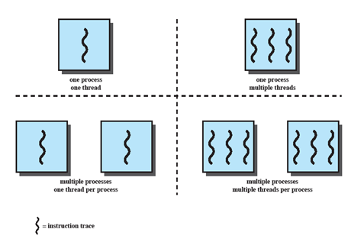
Multithreading
The ability of an OS to support multiple, concurrent paths of execution within a single process.

Slide 5
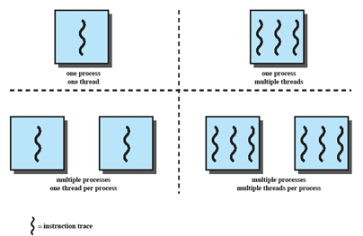
Single Thread
Approaches
MS-DOS supports a single user process and a single thread.
Some UNIX, support multiple user processes but only support one thread per process

Slide 6
Multithreading
Java run-time environment is a single process with multiple threads
Multiple processes and threads are found in Windows, Solaris, and many modern versions of UNIX

Slide 7
Processes
In a multithreaded environment, a process is defined as the unit of resource allocation and a unit of protection. Process is associated with...
A virtual address space which holds the process image
Protected access to
  Processors,
  Other processes,
  Files,
  I/O resources

Slide 8
One or More Threads in Process
Each thread has
  An execution state (running, ready, etc.)
  Saved thread context when not running
  An execution stack
  Some per-thread static storage for local variables
  Access to the memory and resources of its process (all threads of a process share this)

Slide 9
One view…
One way to view a thread is as an independent program counter operating within a process.

Slide 10
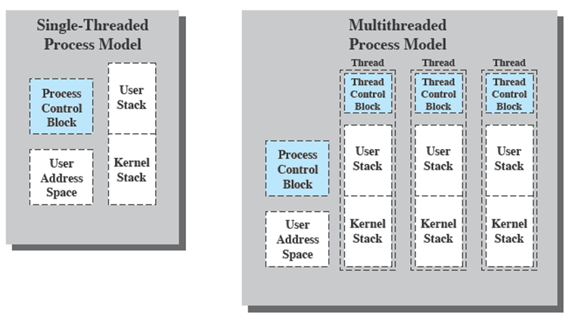
Threads vs. processes

Slide 11
Distinction between threads and processes from the point of view of process management.
In a single-threaded process model, the representation of a process includes
  its process control block
  user address space,
  user and kernel stacks to manage the call/return behaviour of the execution of the process.
While the process is running, it controls the processor registers. The contents of these registers are saved when the process is not running.
In a multithreaded environment,
  there is still a single process control block and user address space associated with the process,
  but separate stacks for each thread,
  as well as a separate control block for each thread containing register values, priority, and other thread-related state information.
Thus, all of the threads of a process share the state and resources of that process.
  They reside in the same address space and have access to the same data.
  When one thread alters an item of data in memory, other threads see the results if and when they access that item.
  If one thread opens a file with read privileges, other threads in the same process can also read from that file.

Slide 12
Benefits of Threads
Takes less time to create a new thread than a process
Less time to terminate a thread than a process
Switching between two threads takes less time that switching processes
Threads can communicate with each other
  without invoking the kernel
If there is an application or function that should be implemented as a set of related units of execution, it is far more efficient to do so as a collection of threads - rather than a collection of separate processes.

Slide 13
Thread use in a
Single-User System
Foreground and background work e.g. spreadsheet
Asynchronous processing e.g. protection against power failure within a word processor
Speed of execution e.g. one thread computes one batch of date while other reading next batch from a device
Modular program structure e.g. input/output

Slide 14
Threads
Several actions that affect all of the threads in a process
  The OS must manage these at the process level.
Examples:
  Suspending a process involves suspending all threads of the process (why??)
  Termination of a process, terminates all threads within the process

Slide 15
Activities similar to Processes
Threads have execution states and may synchronize with one another.
  Similar to processes
We look at these two aspects of thread functionality in turn.
  States
  Synchronisation

Slide 16
Thread Execution States
States associated with a change in thread state
  Spawn (another thread)
  Block
    Issue: will blocking a thread block other, or all, threads
  Unblock
  Finish (thread)
    Deallocate register context and stacks

Slide 17
Example:
Remote Procedure Call
Consider:
  A program that performs two remote procedure calls (RPCs)
  to two different hosts
  to obtain a combined result.

Slide 18
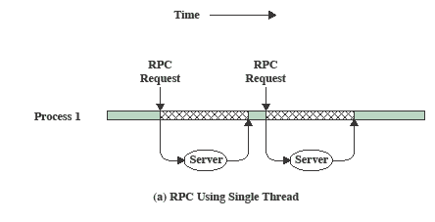
RPC
Using Single Thread

Slide 19
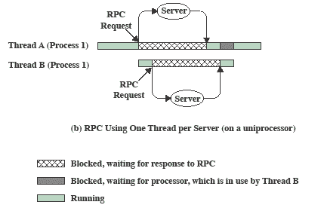
RPC Using
One Thread per Server

Slide 20
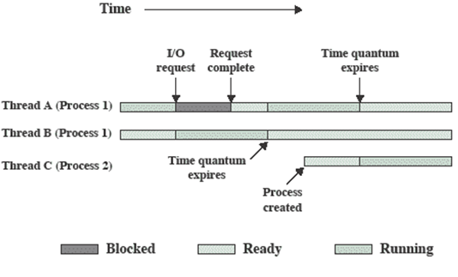
Multithreading on a Uniprocessor

Slide 21
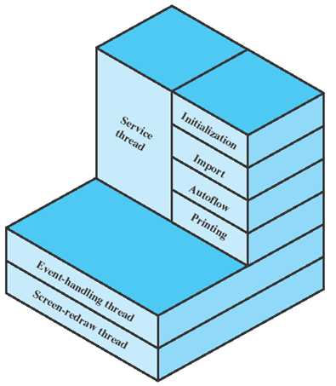
Adobe PageMaker

Slide 22
Categories of
Thread Implementation
User Level Thread (ULT)
Kernel level Thread (KLT) also called:
  kernel-supported threads
  lightweight processes.

Slide 23
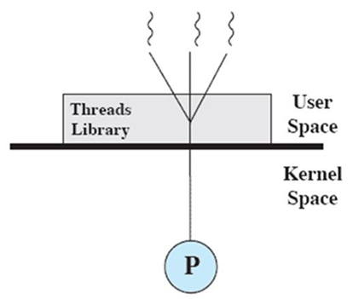
User-Level Threads
All thread management is done by the application
The kernel is not aware of the existence of threads

Slide 24
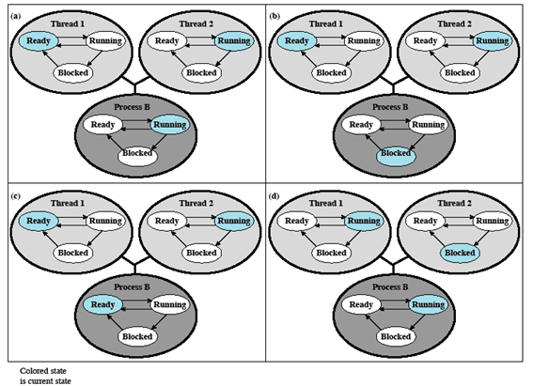
Relationships between ULT
Thread and Process States

Slide 25
Application executing in thread 2 makes a system call that blocks B
Due to clock interrupt kernel determines that time slice is exhausted and places process B in ready state
Thread 2 reached a point where it needs some action performed by thread 1 which blocks thread 2 and makes thread 1 running

Slide 26
Advantages of ULT
Thread switching does not require kernel mode privileges bcoz all thread management is within user address space
Scheduling can be application specific
ULTs can run on any OS. No changes are required to kernel to support ULTs
The threads library is a set of application-level functions shared by all applications.

Slide 27
Disadvantages of ULTs
In a typical OS, many system calls are blocking. When a ULT executes a system call, all of the threads within the process are blocked.
In a pure ULT strategy, a multithreaded application can’t take advantage of multiprocessing

Slide 28
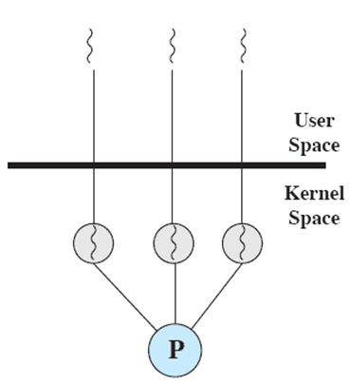
Kernel-Level Threads
Kernel maintains context information for the process and the threads
  No thread management done by application
Scheduling is done on a thread basis
Windows is an example of this approach

Slide 29
Advantages of KLT
The kernel can simultaneously schedule multiple threads from the same process on multiple processors.
If one thread in a process is blocked, the kernel can schedule another thread of the same process.
Kernel routines themselves can be multithreaded.

Slide 30
Disadvantage of KLT
The transfer of control from one thread to another within the same process requires a mode switch to the kernel

Slide 31
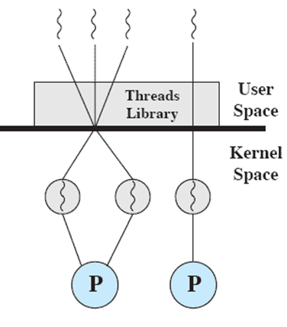
Combined Approaches
Thread creation done in the user space
Bulk of scheduling and synchronization of threads by the application
Example is Solaris

Slide 32
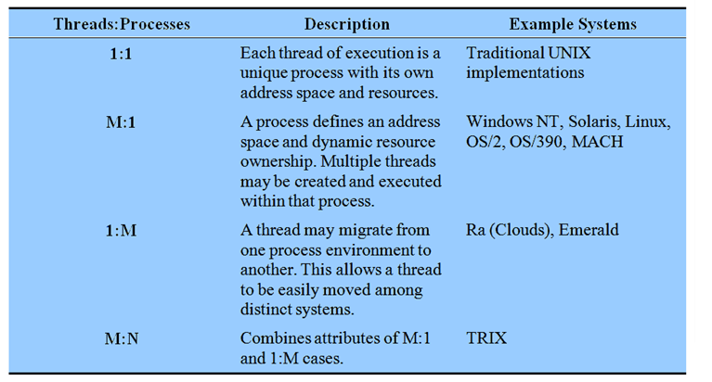
Relationship Between
Thread and Processes

Slide 33
Traditional View
Traditionally, the computer has been viewed as a sequential machine.
  A processor executes instructions one at a time in sequence
  Each instruction is a sequence of operations
Two popular approaches to providing parallelism
  Symmetric MultiProcessors (SMPs)
  Clusters (ch 16)

Slide 34
Categories of
Computer Systems
Single Instruction Single Data (SISD) stream
  Single processor executes a single instruction stream to operate on data stored in a single memory
Single Instruction Multiple Data (SIMD) stream
  Each instruction is executed on a different set of data by the different processors

Slide 35
Categories of Computer Systems
  Multiple Instruction Single Data (MISD) stream (Never implemented)
  A sequence of data is transmitted to a set of processors, each of execute a different instruction sequence
Multiple Instruction Multiple Data (MIMD)
  A set of processors simultaneously execute different instruction sequences on different data sets

Slide 36
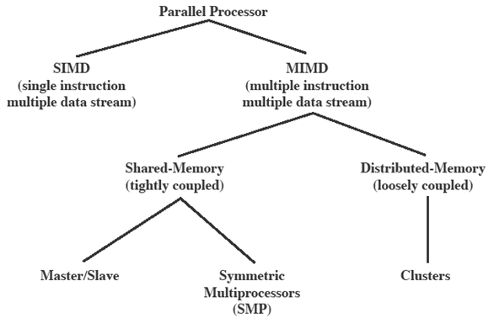
Parallel Processor
Architectures

Slide 37
Symmetric
Multiprocessing
Kernel can execute on any processor
  Allowing portions of the kernel to execute in parallel
Typically each processor does self-scheduling from the pool of available process or threads

Slide 38
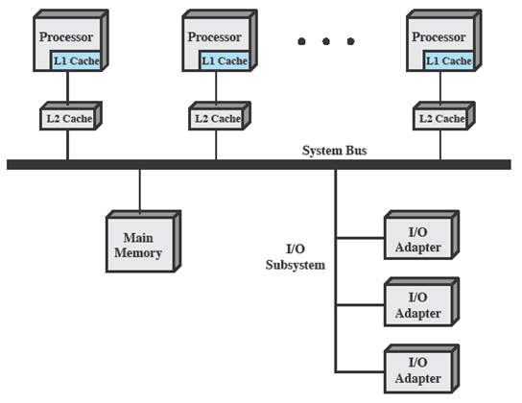
Typical
SMP Organization

Slide 39
Multiprocessor OS
Design Considerations
The key design issues include
  Simultaneous concurrent processes or threads
  Scheduling
  Synchronization
  Memory Management
  Reliability and Fault Tolerance

